Slide 2
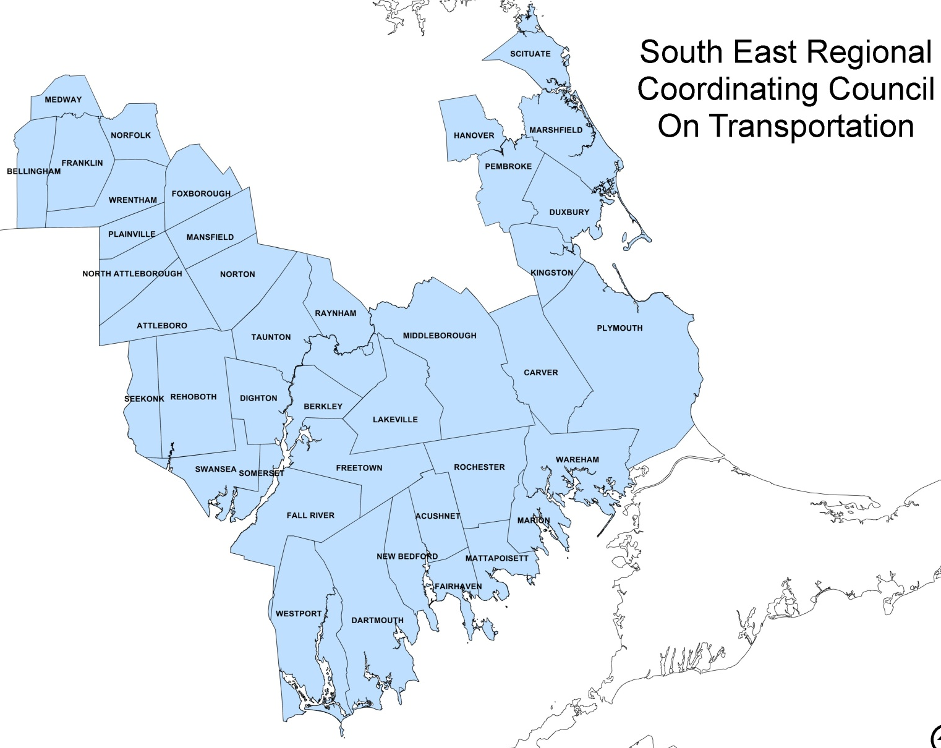
Who We Are
South East Regional Coordinating Council on Transportation (SERCCOT)
Members include:
Regional Transit Authorities (GATRA, SRTA)
Regional Planning Agencies (SRPEDD, OCPC, MAPC)
State Human Service Agencies
Elder Affairs (ADRCs, AAAs, COAs)
Community Organizations (United Way)
Educational Institutions (BCC)
Organizations Serving the Homeless (SOCO, Catholic Social Services)
Labor and Workforce Development (Career Centers, Chamber of Commerce, WIBs)
Private Transportation Providers
Independent Living Centers
Businesses
Transportation Advocates

Slide 3
What We Do
SERCCOT Accomplishments Since 2013
Conducted a Medical Transportation Unmet Needs Survey – October 2014
Hosted Making Connections Medical Forum – November 2014
Applied for Tufts Health Foundation Grant – July 2015
SERCCOT Subcommittee currently working on a Transportation Toolkit – Ongoing
SERCCOT Subcommittee met with Wareham Stakeholders to talk about vehicle sharing and coordination opportunities in the greater Wareham area – June through August 2015
Conducted Work & Education Unmet Transportation Needs Survey – October 2015
Ways to Work & School Transportation Forum – November 2015

Slide 4
Senator Michael Rodrigues
State Senator representing the Massachusetts First Bristol and Plymouth District
Representing the Cities and Towns of:
Fall River
Freetown
Lakeville
Rochester
Somerset
Swansea
Westport

Slide 5
Understanding the Challenges
Rural Communities with Sparse Fixed Route Bus Service
Lack of Intercity Connections
Last Mile Connections
Fixed Route Public Bus Routes to Suburban/Rural Work Places and Educational Institutions
Political Barriers and Boundaries
Limited Knowledge of Existing Transportation Options
Services Not Consistent Throughout the Region

Slide 6
Understanding the Challenges
Coordinated Human Service Transportation Plan
Updated in 2014
Identified Service Gaps and Regional Needs
GATRA/SRTA Connection
Increased access to Bristol, Massasoit, and Cape Cod Community Colleges and Bridgewater State University
Boston Hospitals/Veterans Hospitals
Intercity Connections
Taunton and Brockton
Taunton and Fall River
Attleboro and Fall River
Wareham and New Bedford
New Bedford and Taunton

Slide 7
Understanding the Challenges
Residential Transit Orientation Index (RTOI)
Uses:
Population Density
Age, 6-19yrs
Age, 60+
Income less than $25,000/year
Households with Zero Vehicles

Slide 10
Unmet Transportation Needs Survey
Unmet EMPLOYMENT and EDUCATION Needs Surveys
Sent out as a pre-survey to those invited to the forum
Closed on October 30th
Results from both surveys are included in your folders.

Slide 11
Unmet Transportation Needs Survey
EMPLOYMENT | EDUCATION
70% | 75%
Employees/Clients | Students/Staff
in the past 12 months missed work/job appointments/educational opportunities due to lack of transportation.

Slide 12
Unmet Transportation Needs Survey
EMPLOYMENT | EDUCATION
81% | 88%
Employees/Clients | Students/Staff
in the past 12 months have said lack of transportation was a barrier to keeping or getting a job and/or attending school.

Slide 13
Unmet Transportation Needs Survey
Unmet Intercity Connections
EMPLOYMENT | EDUCATION
#1 – Attleboro and Fall River #2 – Taunton and New Bedford #3 – New Bedford and Wareham #4 – Attleboro and New Bedford #5 – Wareham and Taunton #6 – Wareham and Boston | #1 – Attleboro and Fall River #2 – Taunton and New Bedford #3 – Plymouth and Brockton #4 – Plymouth and Taunton #5 – New Bedford and Wareham #6 – New Bedford and Plymouth
Others – Taunton to Fall River, New Bedford/Fall River to Boston, Wareham to Brockton, Taunton/Attleboro to Brockton/Bridgewater | Others – Marshfield to Cape Cod Community College, Fall River/New Bedford/Taunton/Attleboro to Bridgewater

Slide 14
Unmet Transportation Needs Survey
EMPLOYMENT | EDUCATION
46% | 38%
Employees/Clients | Students/Staff
less than 50% drive their own car to work/school.

Slide 15
Unmet Transportation Needs Survey
Trip Origins
EMPLOYMENT | EDUCATION
Predominantly in the 4 cities (New Bedford, Fall River, Taunton, Attleboro) | Predominantly in the 4 cities (New Bedford, Fall River, Taunton, Attleboro) But also: Mansfield, Marshfield, Hanover, Plymouth

Slide 16
Unmet Transportation Needs Survey
EMPLOYMENT | EDUCATION
84% | 71%
Employees/Clients | Students/Staff
use a fixed route public bus to get to work/school.

Slide 17
Unmet Transportation Needs Survey
EMPLOYMENT | EDUCATION
92% | 71%
Employees/Clients | Students/Staff
provide information about transportation to their employees/clients and that information is predominantly about fixed route public bus or Dial-a-Ride/Van Services.

Slide 18
Unmet Transportation Needs Survey
Most respondents stated that their place of business is located near a local fixed-bus route.
Most respondents feel they are familiar with transportation in their area and would like to provide information about transportation options to their employees/students.

Slide 19
Unmet Transportation Needs Survey
EMPLOYMENT | EDUCATION
72% | 57%
Employees/Clients | Students/Staff
stated that they DO NOT partner with other organizations to provide transportation but 100% answered that they would be interested in learning more about transportation coordination efforts in their area. | stated that they DO partner with other organizations to provide transportation and 71% answered that they would be interested in learning more about transportation coordination efforts in their area.

Slide 20
Unmet Transportation Needs Survey
Interested in learning more about the following programs: | EMPLOYMENT | EDUCATION
Public Transportation | 70% | 86%
Transportation Coordination | 100% | 71%
Employer Transit Pass Program | 42% | ---
Online Ridematching (MassRIDES) | 54% | 57%
Commuter Incentives | 29% | 57%
Emergency Ride Home Program | 58% | 43%
Vanpool Formation and Support | 54% | 29%

Slide 21
Ways to Work and School: Transportation Options 2015
Adam Blye, Outreach Coordinator

Slide 22
Encouraging Mode Shift
MassRIDES = Statewide Travel Options Program
Mission: - Reduce Traffic Congestion - Reduce emissions / improve air quality
How We Accomplish This: - Work With Employers - Outreach / Worksite Services (marketing, posters, tax info, other tools & resources) - Emergency Ride Home Program (for employees only) - Ride-matching (NuRide) and rewards program

Slide 23
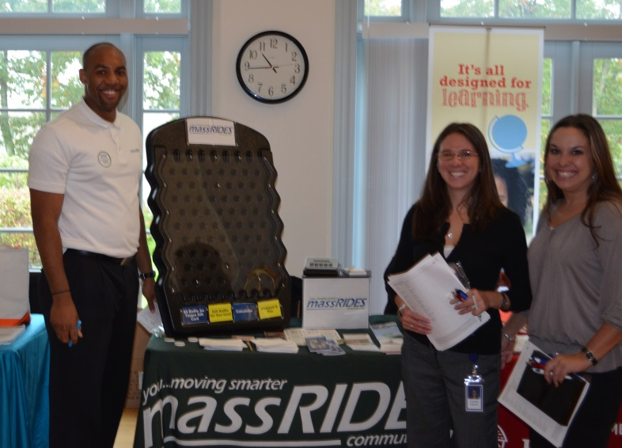
MassRIDES Outreach
Commute Options Programs
Marketing – newsletters, orientations
Emergency Ride Home
Onsite events
Preferential parking
Bike racks, showers, lockers
Transit passes available
Monthly promotions
Transit, vanpool subsidies
Formal telework, CWW
Pre-tax benefits
Shuttle, carshare
Incentives

Slide 24
Policies & Initiatives
Reduce Green House Gas emissions
Reduce drive-alone trips
Active transportation choices
Increase bicycle and pedestrian travel
Sustainable transportation practices
Smart growth development

Slide 25
Special Promotions

Slide 26
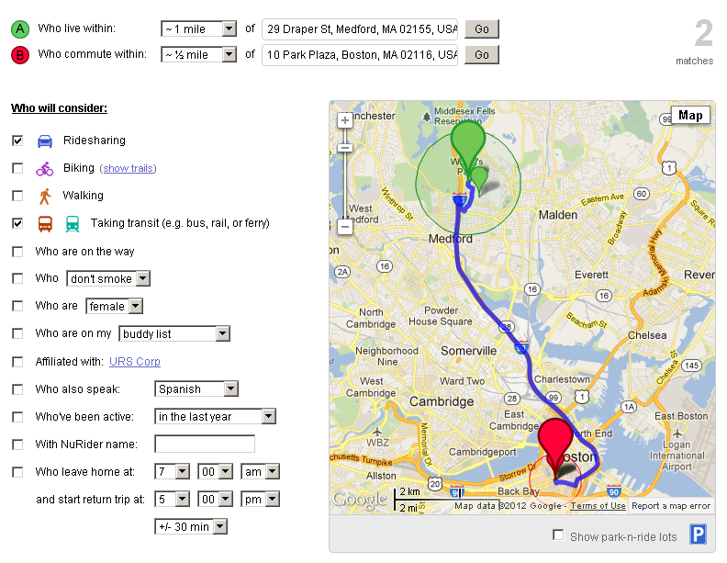
MassRIDES Programs
Online Ride Matching
Carpooling
Bike/Walk
Park & Ride Lots
Vanpooling
Home/work location
Hours
Preferences
Commuters determine arrangements and details

Slide 27
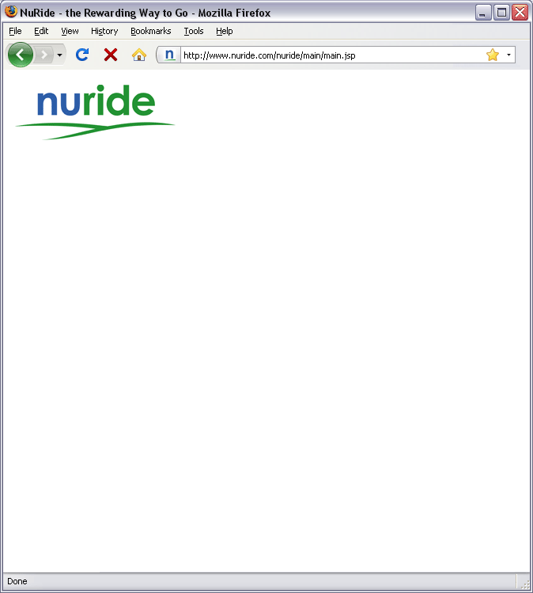
MassRIDES Programs
NuRide Incentives
Get Rewards for Greener Trips
Trip Calendar
Earn Points – Redeem Rewards
Earn Points – Redeem Rewards
saved $887
prevented 3 tons
earned 70,200 pts

Slide 28
NuRide
Green trips include
carpooling and vanpooling
taking public transportation
walking, biking, telecommuting, and working a compressed week
Notes:
NuRIDE is both the State’s ride matching database for carpoolers and vanpoolers along with tracking all alternative modes of transportation-transit, walking, biking.

Slide 29
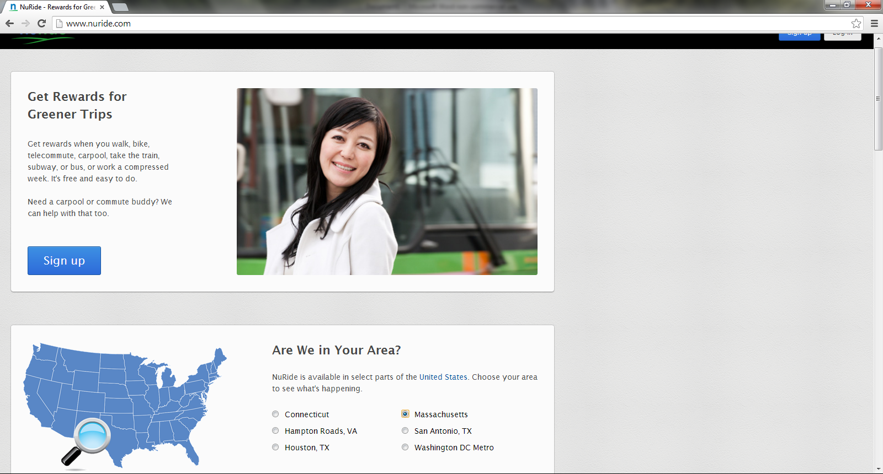
Notes:
This is the NuRide home page where your employees can log in or if their not already signed up- signup

Slide 30
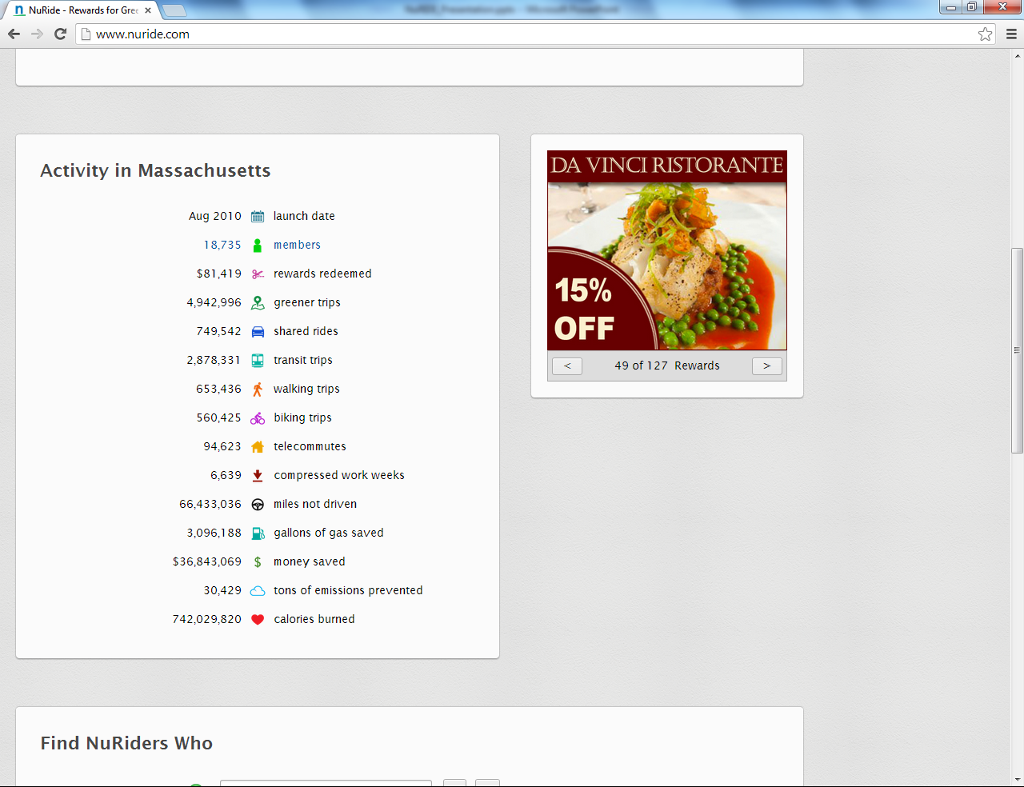
Notes:
A little further down on the page it shows the number of NuRide members currently at 18k in Massachusetts along with the number of alternative trips by mode, and also highlights 66 million miles not driven and 3 million gallons of gas saved by taking those modes.
With the new changes-they can now use their mobile devices-smartphones, tablets to sign up!
What’s even better is that now when your TMA register’s your employees for NuRIDE at transportation events automatically into NuRide ---there is no more two step process of pre-registration then an employee e-mail to register.

Slide 31
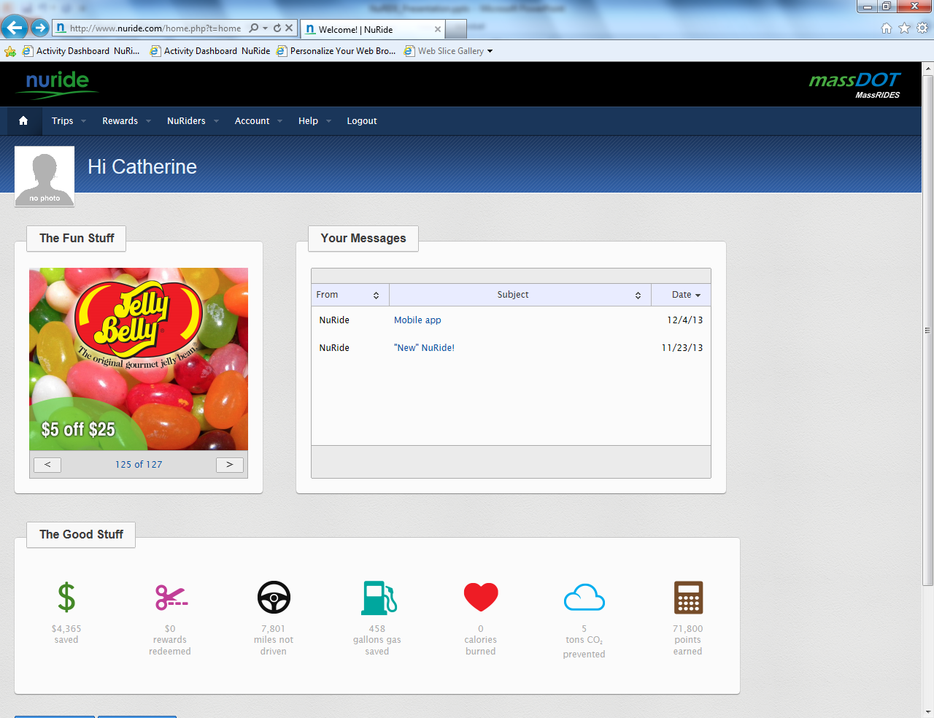
Notes:
Once your employee is registered and log’s into their account they automatically see this page that shows rewards that are available and how their efforts are making a difference with savings, miles not driven, gallons of gas saved.
Because their automatically registered in NuRide a good amount of their profile is already completed.

Slide 32
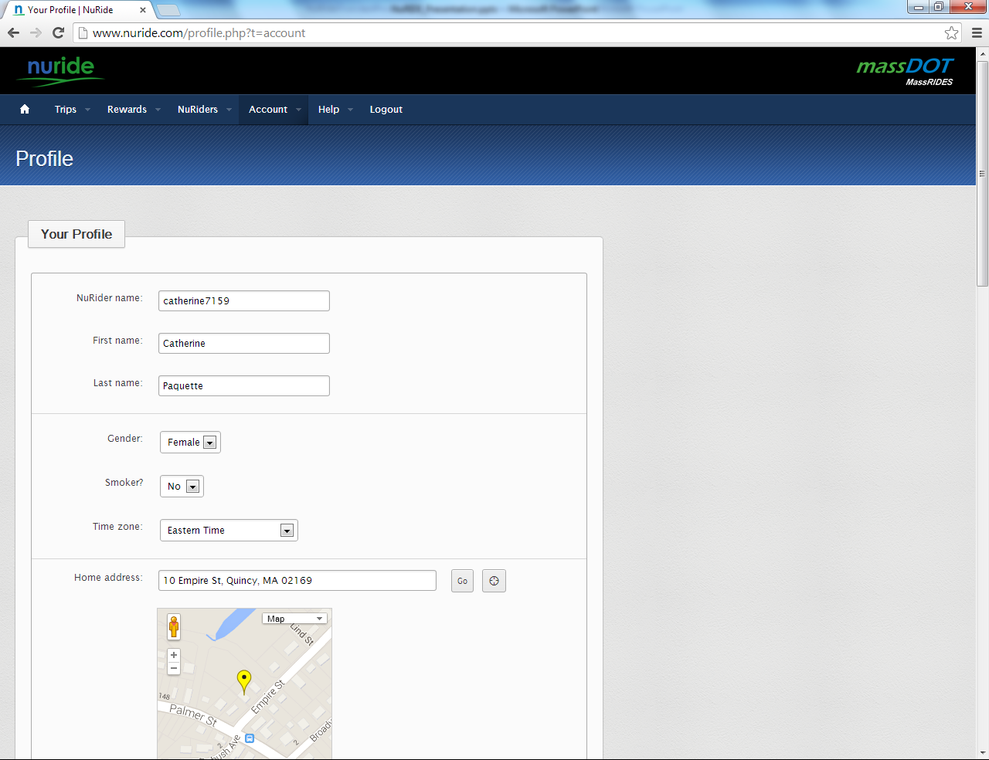
Notes:
Go to Account at the top of the page and click on profile to see that information

Slide 33
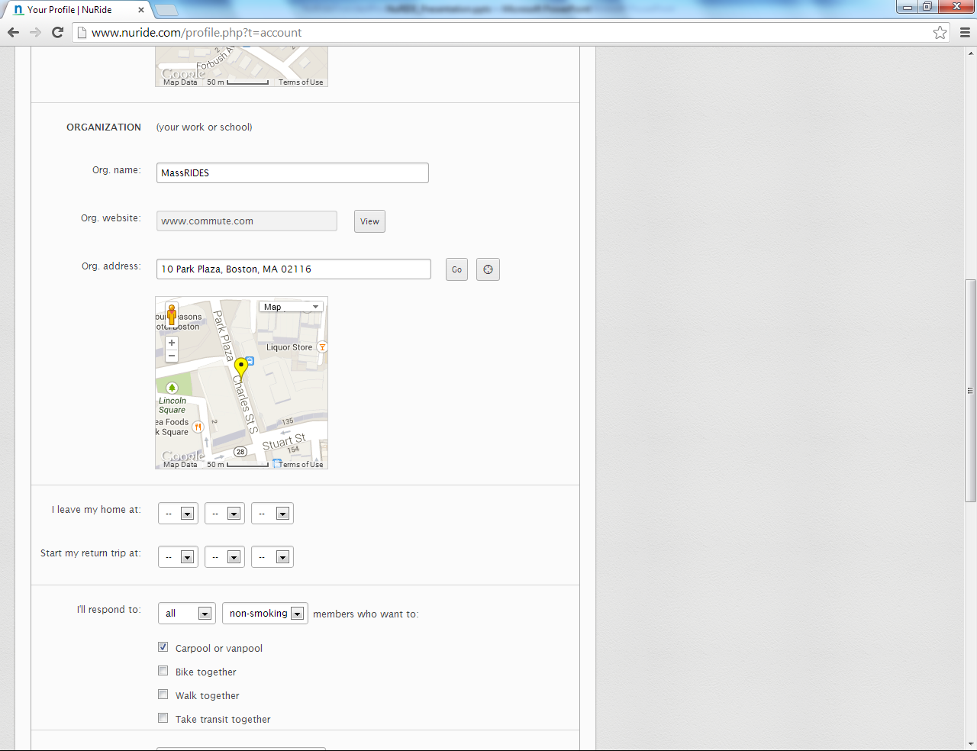

Slide 34
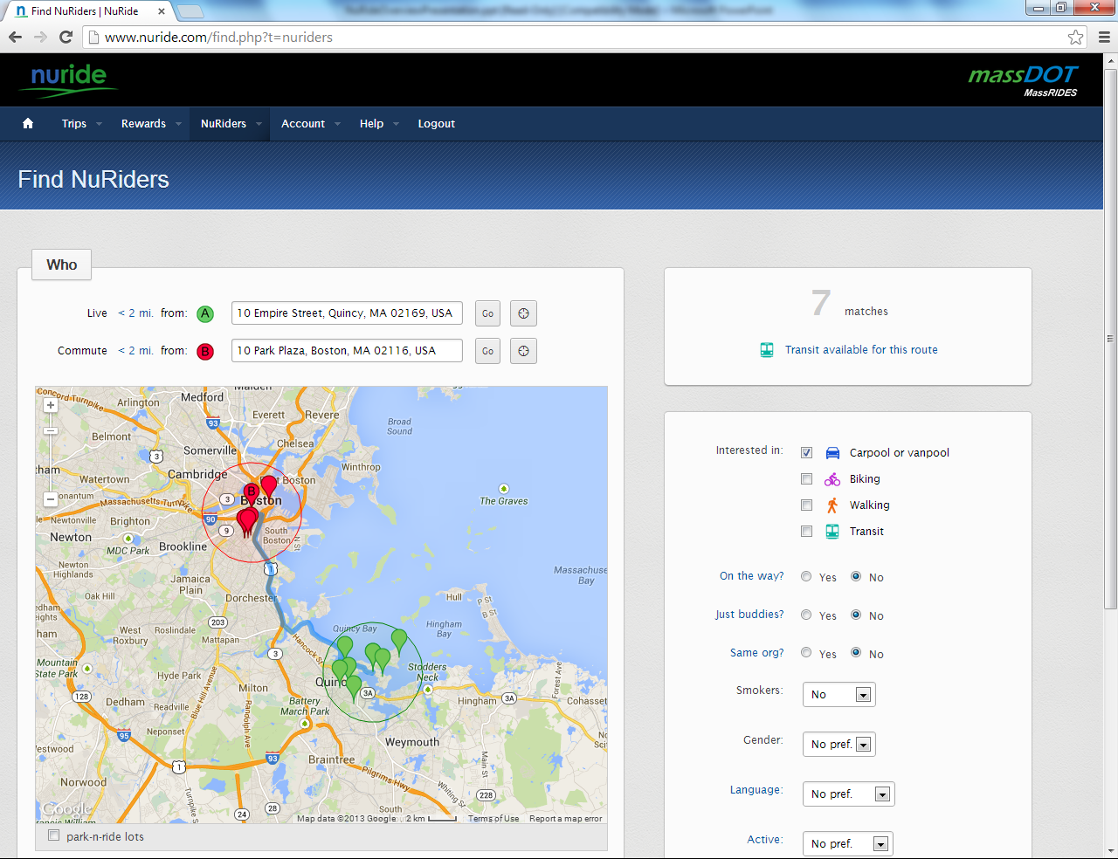

Slide 35
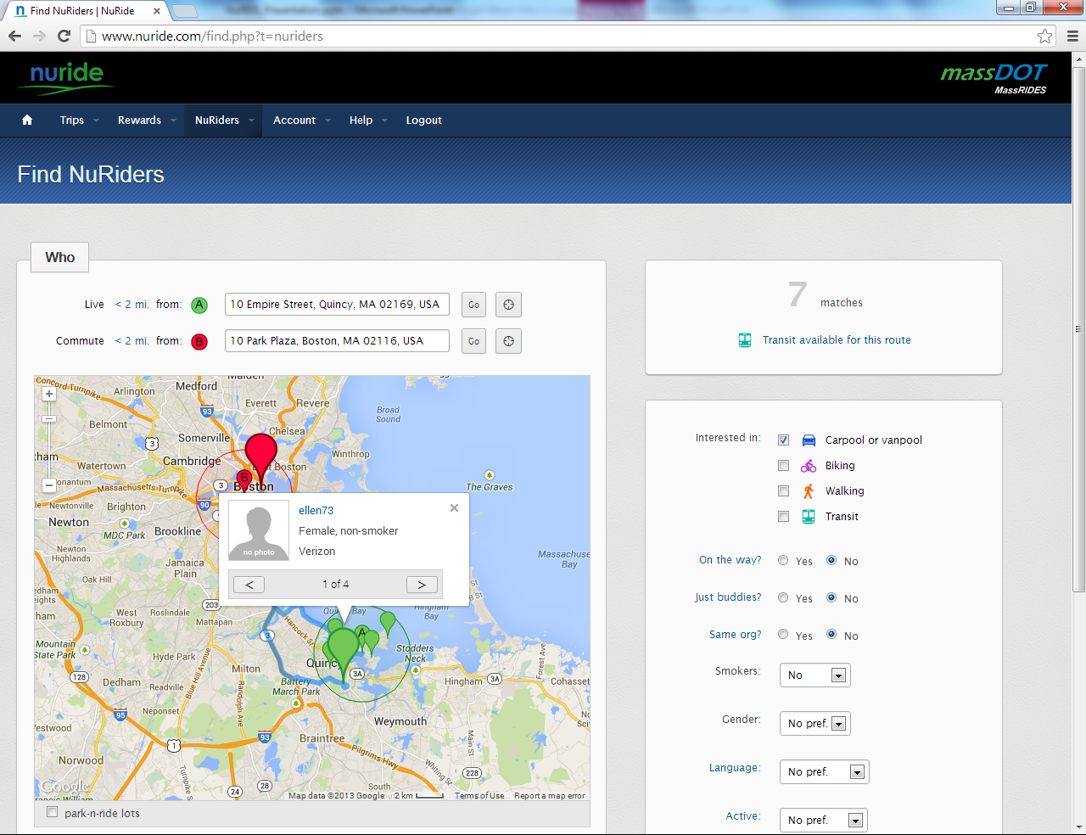

Slide 36
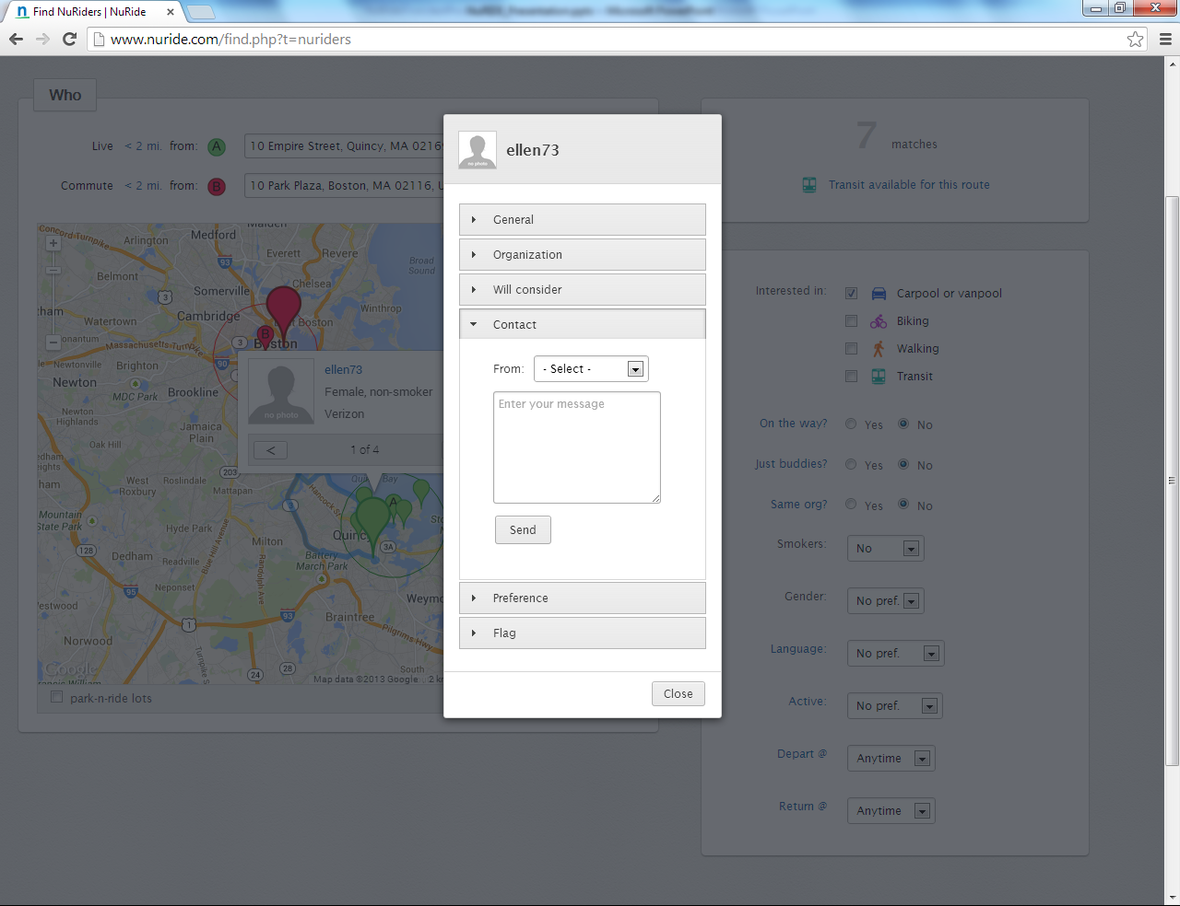

Slide 37
NuRide
Record Work and Personal Trips
bus to work
Earn points for all green trips
Register and receive 1,000 points
bike to friend’s

Slide 38
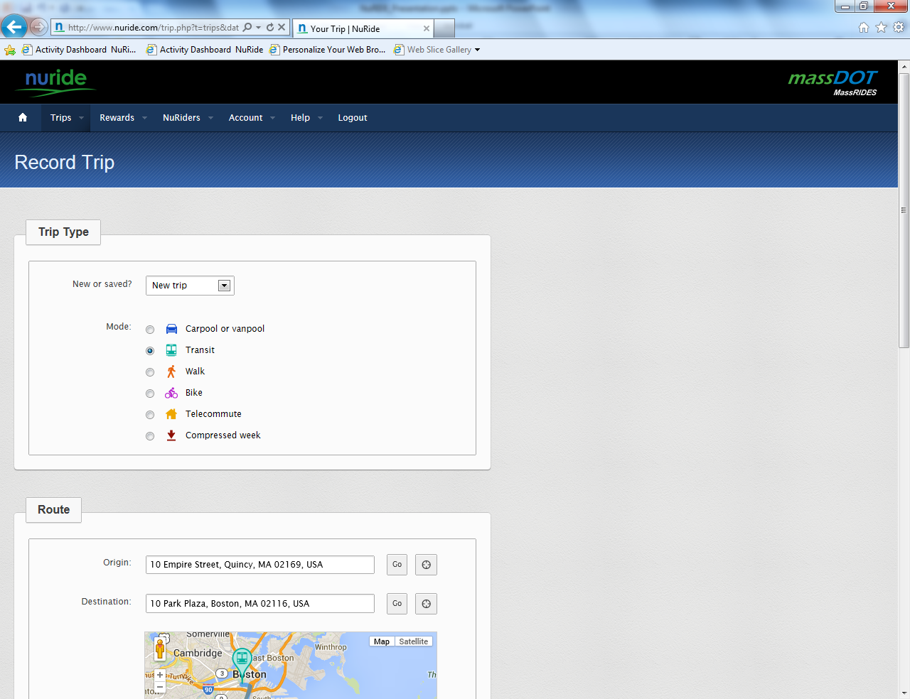
Notes:
Because their profile is already in NuRide your employees can go directly to record a trip.
This new version has made it really easy to record trips on one page without needing to go to the calendar first.
They first put in type of trip. I entered transit because that’s how I get to work and then the days

Slide 39
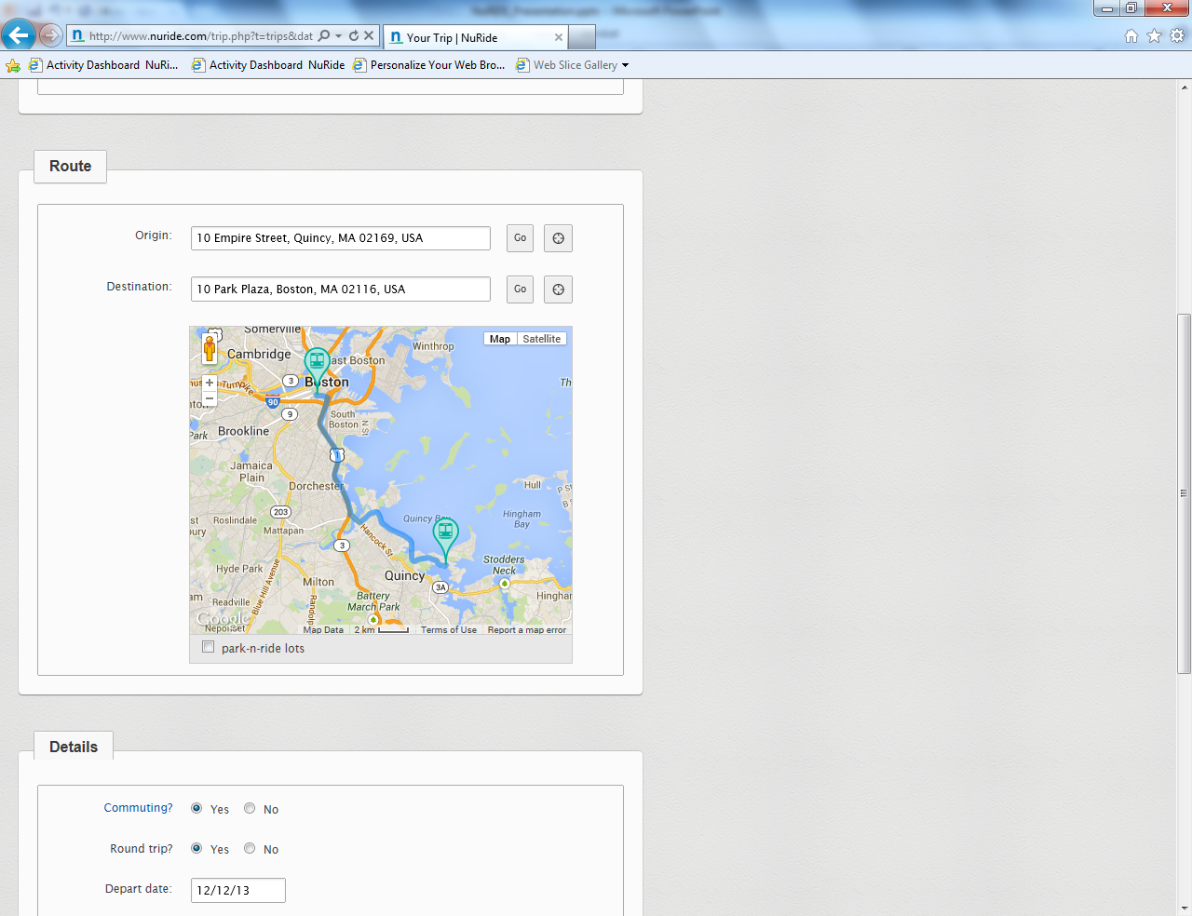
Notes:
Route locations: origin and destination
Trips are shown on a map as the user enters the locations.

Slide 40
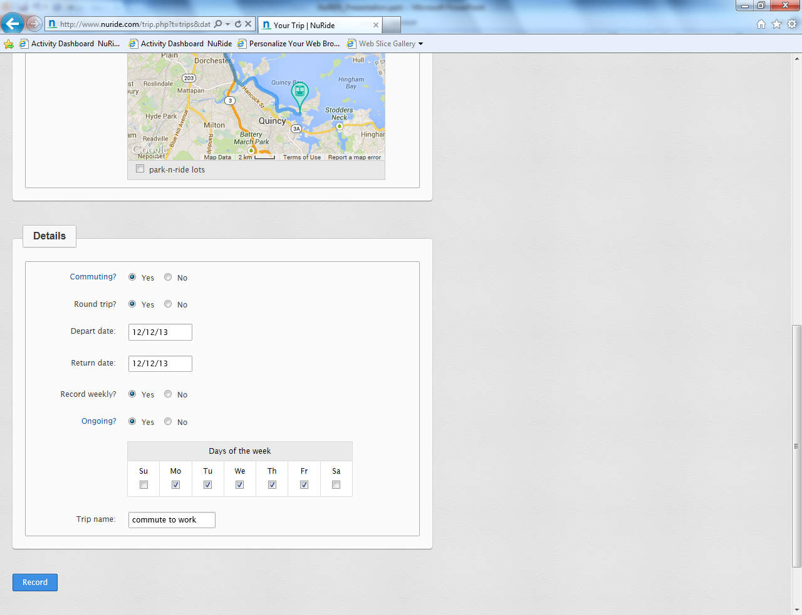
Notes:
A few additional details! And your done!

Slide 41
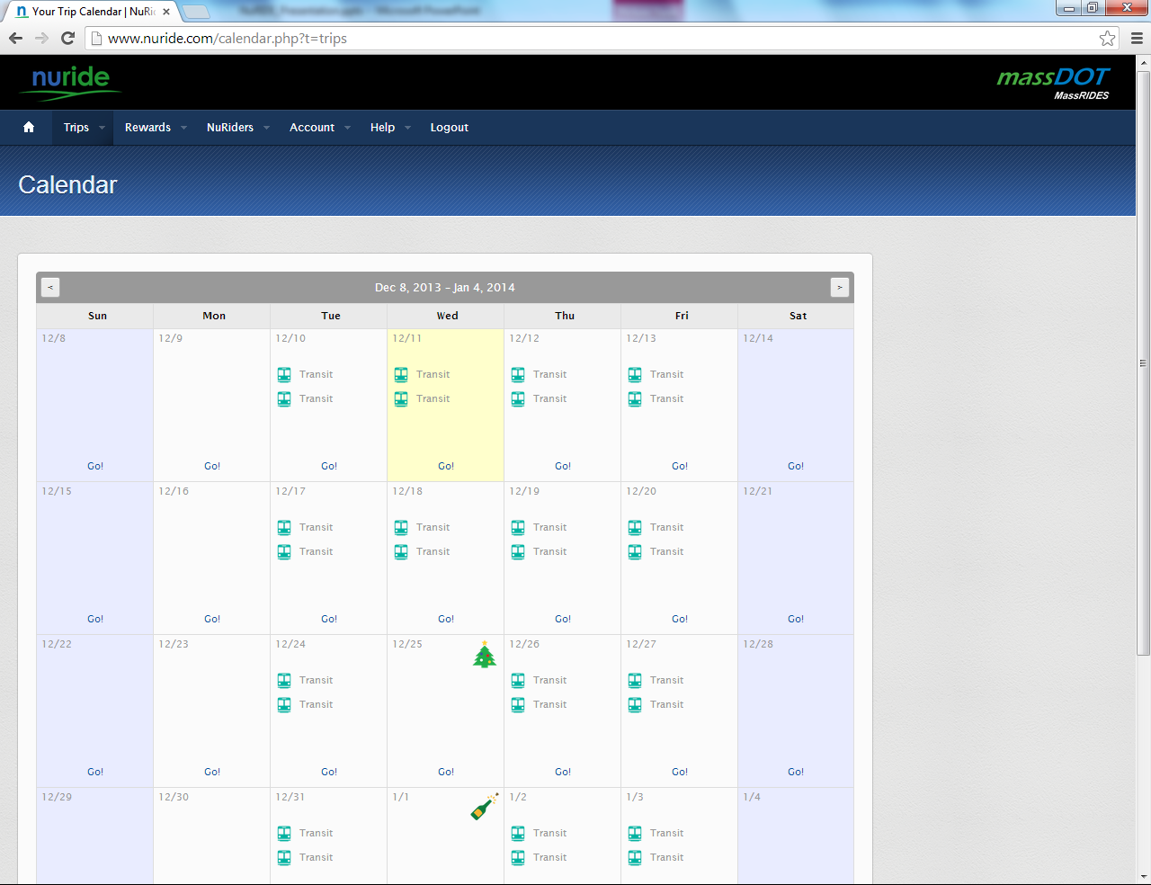
Notes:
To view your trips in a calendar under trips click on Calendar.
Click on Trip profiles-to edit, delete recorded trip.
Can also click on ICON to edit that particular trip.
When you click on Go -you have the option to record another trip or mark as day off.

Slide 42
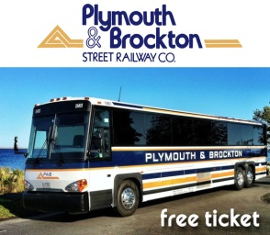
NuRide
Restaurant coupons
300 points
Redeem points for rewards
Retailer discounts
2000 points
Ticket promotions
1,000 points
Notes:
1,000 points can equal to
With 500 points you can get $5 off a $25 purchase at Cambridge Brewing company or
For 1k points-15% off at Da Vinci Italian Restaurant here in Boston on Columbus Ave.

Slide 43
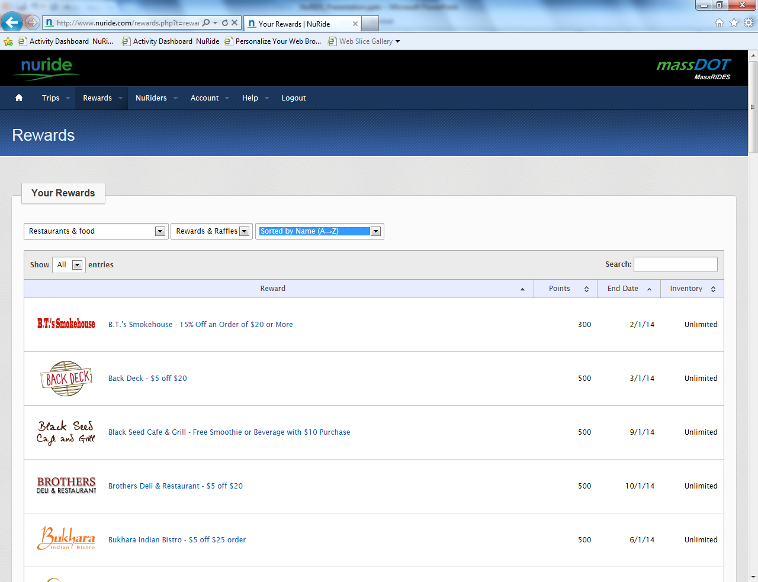
Notes:
To view the rewards your eligible click on rewards and you’ll see you can sort them by name, popularity. Narrow your search as I did to restaurants and food.

Slide 44
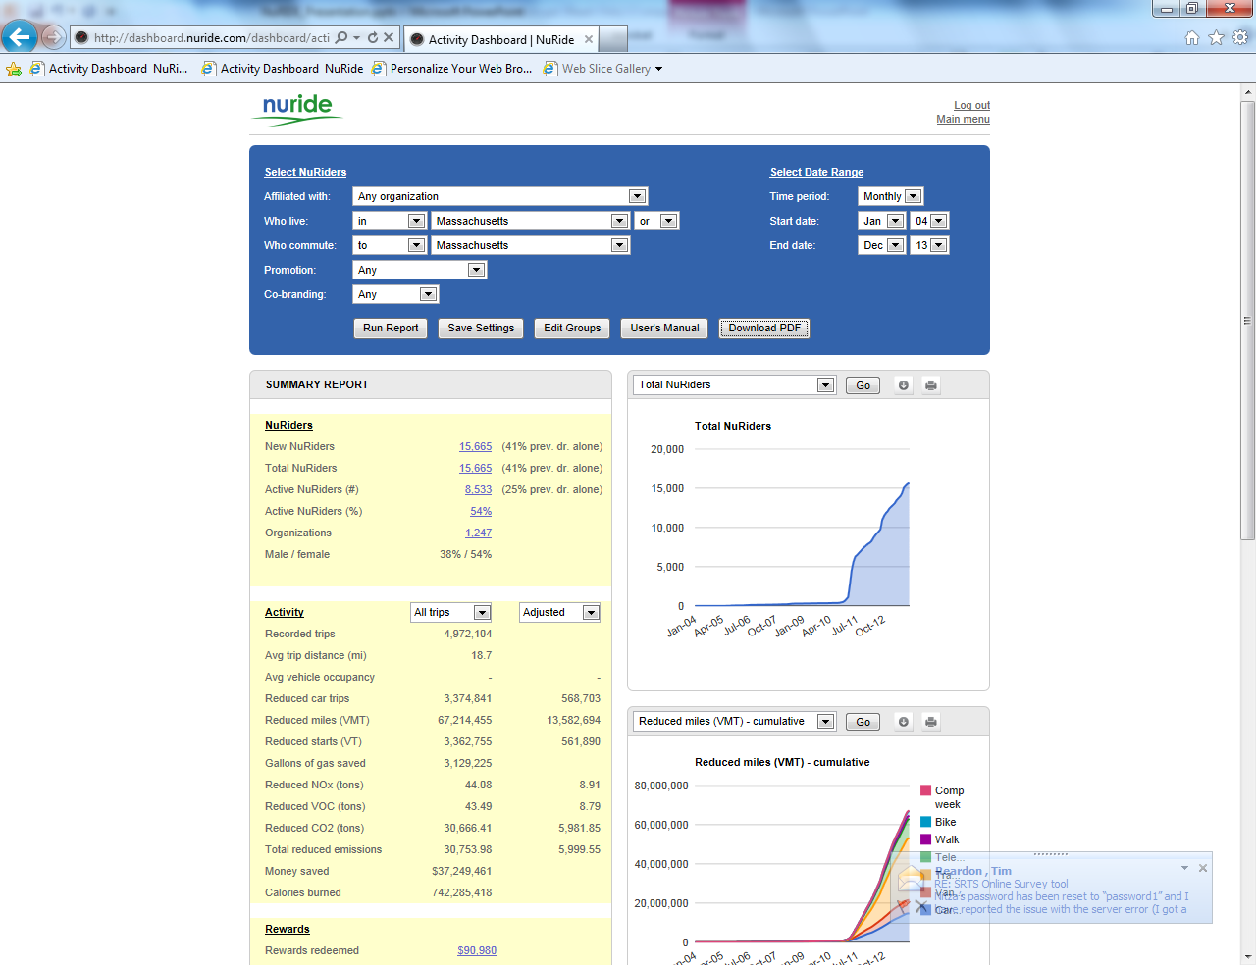
Notes:
Here is a report that you TMA contact can provide your organization on your employee activity.

Slide 45
Adam Blye Adam.Blye@dot.state.ma.us 857-368-8640
www.commute.com
Notes:
To wrap up, we’re really excited about NuRIDE now being
Mobile
Easier to use both in recording trips and finding rewards!
I hope this was helpful and if you have any questions please feel to contact me or TMA contact.
Thank you

Slide 46
RIDE MATCH www.massridematch.org
Presented by Mary Basilone, Mobility Manager, GATRA
509-823-8828 www.gatra.org

Slide 47
Project History
In 2010, GATRA was awarded a Mobility Management grant to design and implement services for older adults, people with disabilities, and persons with low incomes
Our intent was to create a database that would connect people with accessible transportation options
In 2011, completed an initial assessment of available services in South Eastern Massachusetts. The inventory included all public, private, non-profit and community-based transportation providers
In 2012, worked with developer and created Ride Match
In 2015 awarded MassDOT Community Transit Grant to expand database statewide

Slide 48
What is Ride Match?
An online searchable database of transportation providers in Massachusetts
A single point of access to information about travel and transportation options
A network of multiple transportation providers meeting a variety of travel needs
Ride Match DOES NOT provide transportation

Slide 49
What is Ride Match?
Online search tool
A to Z List of providers
Provider login
Useful Links section
www.massridematch.org

Slide 50
What are the Benefits?
Consolidates provider information
Improves customer service
Improves service accuracy and efficiency
Tracks unmet needs
Becomes a planning tool for future services
Offers more mobility options to riders

Slide 51
What’s in the Database
Over 700 separate records
Over 60 private providers in South Eastern MA and many more state-wide
Over 40 Councils On Aging
Over 40 non-profit and community-based providers
Bus Routes – Complete for GATRA, SRTA, CCRTA, BAT, and MetroWest
All MBTA Bus Routes & Commuter Rail Lines

Slide 52
Ride Match Statistics
Began tracking searches in June 2013
Over 20,000 individual users
Over 100,000 online searches performed
Most popular destinations to date:
Boston, Brockton, Fall River, New Bedford, Plymouth, Providence, Taunton, Attleboro, Mansfield, Jamaica Plain, Foxboro, Hyannis, Worcester, Raynham, Framingham, Quincy, Dartmouth, Franklin, Pawtucket, Plainville, Wareham, Dorchester, Ashmont, Bourne

Slide 53
Google Analytics Map of Ride Match Searches by Location
Ride Match Statistics
Boston
Brockton
Plymouth
Attleboro
Taunton
Fall River
New Bedford

Slide 54
Searches by Location and Results (09/01/15 – 11/10/15)
Ride Match Search Results

Slide 55
Ride Match: In Planning
Expand the Ride Match database to include all regions and towns in Massachusetts – Beginning with BRTA, FRTA, NRTA, and WRTA
Develop a geo-mapping system that is linked to the Ride Match search function
Provide active scheduling “Request a Trip” feature
Provide link to 2-1-1 for other services – emergency services, housing, hunger – see njfindaride.org
Provide link to Mass Rides for commuter options
Provide link to NuRides for greener trip rewards

Slide 56
Examples of Transportation Solutions
READYBUS – transportation service for seniors & people with disabilities opened up their vehicles in 4 of their 21 towns to allow employment transportation customers to ride alongside the seniors to fill empty seats.
CrossTown Connect – town-led TMA has both employers & towns as members, provides benefits to employees & also joint dispatch for Councils on Aging
GATRA’s North Plymouth after school public bus service
GATRA’s public/private partnership with Sensata
Berkshire Rides Vehicle Share Model

Slide 57
World Cafe
Key Words/Definitions Used in World Café Work
Social Innovation
Systems Thinking
Community of Practice
Global Citizenship
Collaborative Inquiry
Diversity
Collective Intelligence

Slide 58
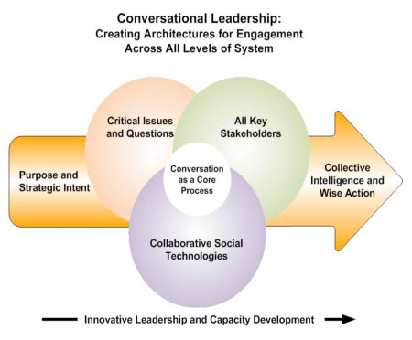
World Cafe
www.theworldcafe.com

Slide 59
Next Steps & Wrap Up
We will be taking the ideas, challenges, and barriers that were developed by the groups today and using them to form initiatives and look for new funding opportunities to solve these problems.
THANK YOU!
Julie Boren, Co-Chair, julie.boren@state.ma.us
Angie Azevedo, Co-Chair, aazevedo@srpedd.org
Mary Basilone, Secretary, mbasilone@gatra.org

